Slide 1
Phishing Awareness Training
An in-depth guide to understanding and preventing phishing attacks

Slide 2

Introduction
This presentation aims to provide a comprehensive overview of phishing, its various types, characteristics, and strategies for prevention. As phishing attacks become increasingly sophisticated, understanding these elements is critical for protecting both individuals and organizations.

Slide 3
01
Phishing Overview

Slide 4
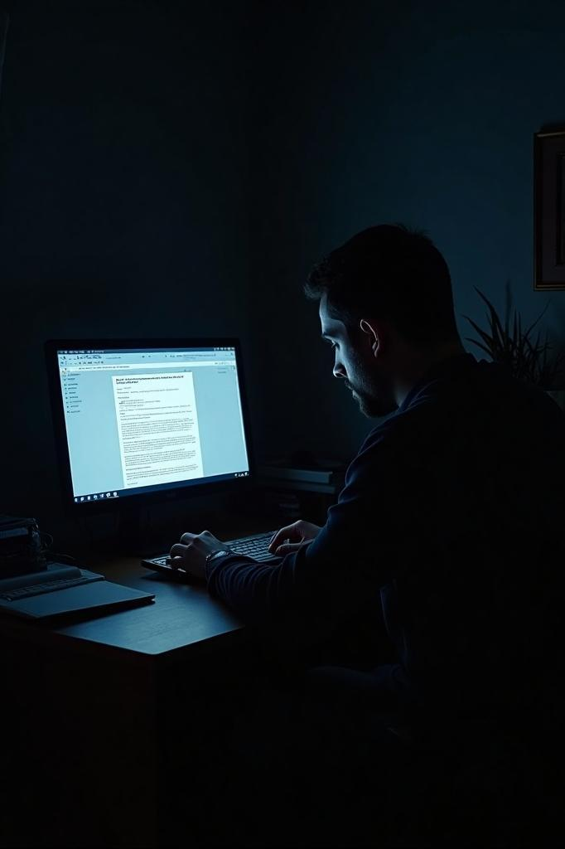
Definition of Phishing
Phishing is a cyberattack method where attackers impersonate trusted entities to deceive individuals into revealing sensitive information, such as usernames, passwords, or financial data. This malicious practice commonly occurs through emails, fake websites, phone calls, or text messages. The term 'phishing' is derived from 'fishing,' as attackers use bait to lure their victims.

Slide 5
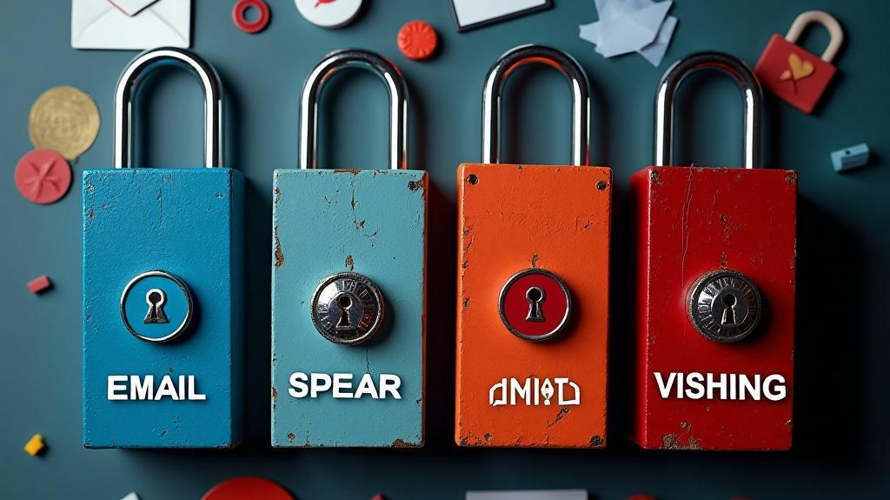
Types of Phishing Attacks
There are several types of phishing attacks, including:
- Email Phishing: This involves mass emails that appear to be from reputable companies, urging recipients to click on malicious links or download harmful attachments.
- Spear Phishing: A targeted approach aimed at specific individuals or organizations, utilizing personal information to enhance the message's credibility.
- Smishing: This form of phishing occurs via SMS, where victims are sent texts containing harmful links.
- Vishing: Also known as voice phishing, this tactic involves scammers calling victims while impersonating legitimate representatives to extract sensitive information.

Slide 6

Characteristics of Phishing Messages
Phishing messages often exhibit specific characteristics designed to deceive recipients into believing they are legitimate. Common features include:
- Generic greetings, such as "Dear User," which indicate an impersonal communication.
- A sense of urgency, often stating that immediate action is required, such as account suspension threats.
- Suspicious sender email addresses that may look similar to official ones but contain slight misspellings.
- Poor grammar or spelling mistakes that undermine the message's authenticity.
- Unusual links, where hovering over them reveals a different destination than what is displayed.
- Unexpected attachments or links that prompt users to click without due caution.

Slide 7
02
Prevention Strategies

Slide 8

Prevention Tips
Implementing effective prevention strategies is crucial to safeguarding against phishing attacks. Recommended practices include:
- Always scrutinize email sender addresses before clicking any links or downloading attachments.
- Hover over links to verify that they direct to legitimate URLs prior to clicking.
- Enable two-factor authentication on all accounts to add an extra layer of security.
- Keep antivirus and anti-malware software updated to protect against malicious software.
- Do not open unexpected attachments, as they may contain harmful content.
- Steer clear of clicking links in unsolicited messages, regardless of their appearance.

Slide 9

Reporting and Responding
In the event of a phishing attempt, prompt action is essential. Follow these steps to report and respond effectively:
- Do not click any links or respond to the suspect message to avoid compromise.
- Report the phishing email to your IT department or email provider for further investigation.
- Immediately delete the suspicious message from both your inbox and trash folder.
- If you have entered any credentials, change your password without delay and notify your cybersecurity team of the breach.

Slide 10
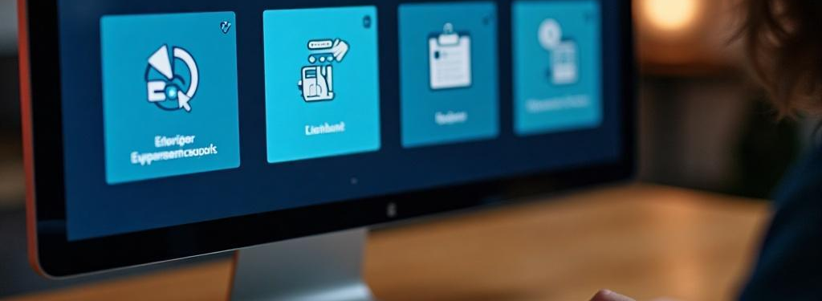
Tools and Resources
Several tools and resources can enhance your ability to combat phishing attacks:
- Anti-Phishing Working Group: Provides updates on the latest phishing trends and tactics.
- Stay Safe Online: Offers valuable cybersecurity tips from the National Cyber Security Alliance.
- Have I Been Pwned: A service that allows users to check if their email addresses have been compromised in data breaches.
- Browser Tools: Major browsers like Chrome and Firefox include built-in phishing protections, helping users avoid malicious websites.

Slide 11

Conclusions
Phishing remains one of the most prevalent and perilous forms of cybercrime. Increasing awareness and vigilance, coupled with robust security practices, can substantially mitigate the risk of falling victim to such attacks. It is imperative that every individual within an organization understands their role in maintaining security and is informed about the evolving landscape of phishing threats.

Slide 12
Thank you!
Presented By : Sobhy Daaboul
@Codealpha

